Slide 1
Weekly Review

Slide 2
Duolingo

Slide 3
Bonus Submissions
Literally none

Slide 4
What is Job Security?
To make your boss more money than it costs to employ you
Or simply, to make your Boss’s job easier
If this was a business that I had to pay for, I would have fired most of you already.
So, instead I will begin giving worse grades
I am equally as bad at giving bad grades as I am at giving praise.
I have to constantly remind myself that I’m grading on whether or not you did it, and not how it will make you feel getting a bad grade.

Slide 5
Professionalism
Seniors are abusing Teams
I have already pulled two seniors aside this year and told them to grow up and stop spamming/meming in Teams during class
The Teams service is not yours. It is the school’s
You are distracting your classmates, which is against my rules
I have Veyon installed on every computer in this class
I can monitor everyone’s computer
But this is a lot more work for me, which means I need to “fire” you instead
We KNOW there is Teams time and Discord time
Meme on Discord when you are out of this class

Slide 6
Professionalism pt.2
Juniors are abusing Teams
We’re done with the webcams. Full stop.
I am very tired of hearing “I’m helping them with so-and-so”
First of all, you have a 60% in this class, so you’re not helping anybody with anything
Second of all, I just HEARD you talking about something totally unrelated
Third of all, I can SEE that you’re not working on school stuff on your computer
Fourth of all, this is literally what Teams is for
Practice “working remote”, call a meeting, or

Slide 7
Professionalism pt3
I have always preferred “carrots” over “sticks”
If I give you a carrot, you seem to think that’s a signal to stop working
You are not motivated by carrots.
I am now considering a Professionalism grade
Uniform
Proper use of school equipment and services
Completion of work and scheduling/messaging important details
Goofing off will lead to increased workloads
Failure to complete additional work will result in bad grades

Slide 8
Incomplete Work
I thought you were goofing off last week because I did not give you enough work, but it turns out people were not doing their work.
25% of Seniors lost a letter grade for not completing their Workload Completion from DocPac 22
3 Juniors were given 0’s on Tablemaker for copying work
Seriously? How do you not know this is cheating?
People still trying to commit the entire node_modules folder in PR
I am having to increase my “spot check” of CIW Labs, as I’m finding more and more incomplete labs

Slide 9
Incomplete Work pt2
Most egregious was the Tablemaker
53% of students cheated, did not submit, or submitted non-working code
THIS IS REQUIRED TO PASS THE NOCTI
You are making my job more difficult by not learning this
It’s incredibly easy to catch you cheating once I suspect you
Very few messages on Teams asking for extensions
Test all code THOUROUGHLY before submitting
This means try to break it on purpose
Submitting broken code greatly increases my workload
IF YOU DID NOT TEST, OR THE CODE DOES NOT WORK AS INSTRUCTED, DO NOT SUBMIT IT
This is exactly how the Formbar broke, and it’s why you are grounded

Slide 10
Example: Testing Your Working Code
cd yourname
npm i
node app.js
Browse to local at the port in your console output
Submit good test data
Submit bad test data
delete node_modules
Give you an A
Repeat 26 times

Slide 11
Example: Testing Your Broken Code
cd yourname
npm i
package.json is missing
npm i express
npm i ejs
node app.js
You didn’t name your application app.js
node index.js
You didn’t name your application index.js either
Look at your folder manually to discover it’s “node.js”, which is the worst name you could possibly choose, and I’ve never taught you to do this
node node.js
Doesn’t work, because you didn’t bother to finish, tell me it wasn’t done, or ask for an extension, and submitted it anyways
Browse to localhost
Realize I don’t know what the port is because you didn’t put it in the console on boot
Navigate to your app.js and read through the code, because you also didn’t use a constant to set your port
Paste good test data
Program doesn’t do what the instructions say
Program outputs data in the console I never asked for
Don’t even bother to paste bad test data
At least I saved a step here
Write on your DocPac why you got a bad grade
Delete node_modules
Give you a 0
Repeat 26 times on my day off
Seniors win SmithPool

Slide 12
OnlyPogs
http://192.168.10.21:1024
Jason Lara, Jaysin Haugh, and Logan Hiller

Slide 13
Formbar.js
No deployment yet, but testing will come soon.
Ethan Shimmel, Riley Royer

Slide 14
Other projects
Gaidos Bank
I’m not sure why this is even being worked on, as Ryan Stevenson already had it 90% done.
New Site Proposal
Is making progress, but is in danger of “infinite tweaking” and subjective goals.
Dudescanner
This project has been passed around the entire class.
Combines old “Caught” and “Ypass” ideas/projects.

Slide 15
This week / Loose Ends
I would say Read the DocPac, but honestly, at this point…?
The DocPac date was wrong the entire time, and out of 26 people, nobody said a word.
The DocPac file had the wrong name, and still nobody said a word.
Many people didn’t follow the instructions on assignments.
The DocPac WILL change this week as I add Junior assignments.

Slide 16
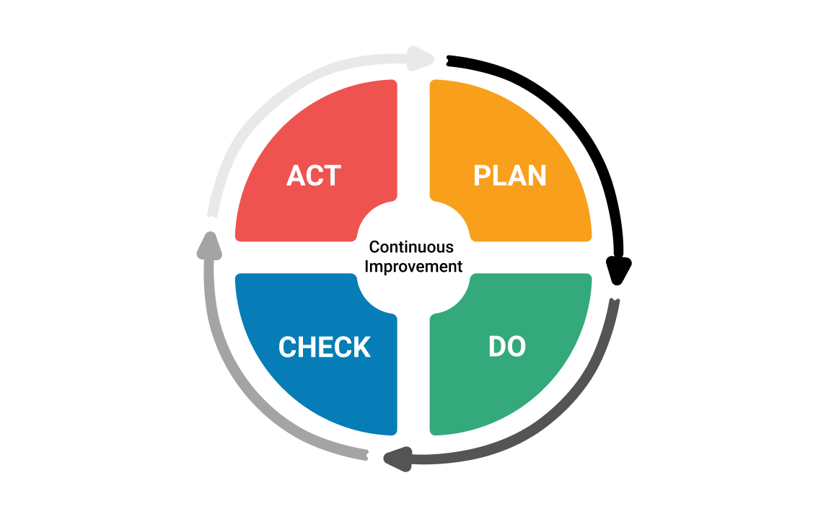
Continuous Improvement

